Slide 1
Dietary Supplements and Regulation Compliance: FDA Interventions with COVID-19 Unproven Medical Claims and Labeling Reviews
LCDR Laura Kennedy
Compliance Officer
Human and Animal Food Division 4E

Slide 2
Overview
In 2020, U.S. e-Commerce retail growth accelerated by more than 34% in just one year, due to the COVID-19 pandemic. Online sales increased to over $709 billion, surpassing a level not expected until 2022. The pandemic-driven circumstances shifted consumer online purchasing to include essential items such as groceries and health care products.
The FDA plays a critical role in ensuring that FDA-regulated products are safe and effective, including products purveyed online, and supports this role through its surveillance and enforcement activities.

Slide 3
Definition of Health Fraud
FDA Compliance Policy Guide 120.500: The deceptive promotion, advertisement, or sale of products as being effective to diagnose, prevent, cure, treat, or mitigate disease, or to provide a beneficial effect on health, but which have not been scientifically proven safe and effective for such purposes.
May be deliberate, or done without adequate knowledge or understanding of the product and its harmful effects.

Slide 4
Online Proliferation
213% increase
in the past 7 years
Notes:
This doesn’t include reports to dedicated COVID reporting mechanisms, OCI reports or other complaints or reports to the agency.

Slide 5
Why should I be concerned about fraudulent products?
Have not been evaluated by FDA for safety and effectiveness
Might be dangerous to you and your family
May cause consumers to possibly delay or stop appropriate treatment leading to more serious complications
Interaction with current medications
Economic fraud
Prey on desperate and elderly consumers
Threatens public health and sound scientific research

Slide 6
How do I know if a product is fraudulent?
Sold online as a supplement/tincture/oil
Be suspicious of products that claim to treat a wide range of diseases.
Personal testimonials are no substitute for scientific evidence.
Few diseases or conditions can be treated quickly, so be suspicious of any therapy claimed as a “quick fix.”
If it seems too good to be true, it probably is.
“Miracle cures,” which claim scientific breakthroughs or contain secret ingredients, are likely a hoax.
Marketed as “research use only” or for “Veterinary Use”

Slide 7
What is FDA doing about this?
Office of Dietary Supplement Branch Assignment
Investigations Branch
Online surveillance
Website reviews by Investigators
Compliance Branch
Advisory actions and referrals to HFB
Dedicated Health Fraud Branch
Office of Criminal Investigations
Federal Trade Commission

Slide 8
COVID-19 Health Fraud Response
Workload skyrocketed in 2020:
1273 fraudulent products
377 fraudulent COVID-19 Test Kits
276 domain registrar abuse complaints
284 online marketplace abuse complaints
146 warning letters issued
6 civil enforcement actions, including 4 Temporary Restraining Orders
Multiple criminal prosecutions
246% increase in federal actions initiated
294% increase in investigations

Slide 9
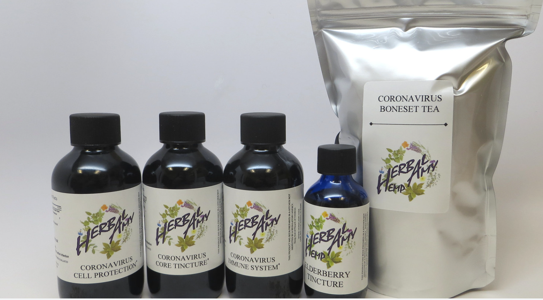
So what are we seeing?
Products intended to directly affect the virus
Notes:
All images are located on public domain https://www.flickr.com/photos/fdaphotos/albums/72157713334402986 and WL are posted on FDA’s public website

Slide 10
So what are we seeing?
Products intended to strengthen the immune system
Notes:
Indirect; but continue to make anti-viral claims specific to COVID or Corona viruses

Slide 11
So what are we seeing?
Biomagnetism for “detecting” virus infection
Copper for “killing viral particles”

Slide 12
So what are we seeing?
Essential oils to “rub on top of hands and feet” to prevent Wuhan Corona Virus
Religious remedies (chlorine dioxide) “cures” or “kills” COVID-19 when ingested

Slide 13
What are these firms being told by FDA?
Current global outbreak of SARS-CoV-2
January 31, 2020; Declared a public health emergency by HHS
March 13, 2020 a National Emergency was declared in response to COVID-19
Product has been identified on website with COVID related claims
Direct quotes of disease related claims (intended to cure, mitigate, treat or prevent) are stated on Warning Letter
Given 48 hours to respond with corrective actions
Failure to immediately correct the violations cited in this letter may result in legal action, including, without limitation, seizure and injunction.
Firm is added to a published list of companies/websites selling products that are false or misleading due to COVID claims and in violation of the FD&C Act
Violations of the Federal Trade Commission Act may result in legal action seeking a Federal District Court injunction and an order may require that you pay back money to consumers.
Civil penalties may be up to $43,792 per violation (COVID-19 Consumer Protection Act)

Slide 14
Where can I report websites selling products with fraudulent COVID-19 claims?
Please report websites selling products with fraudulent claims about treatment or prevention of COVID-19. If you have experienced a bad reaction to a product sold with COVID-19 claims, report it to the FDA’s MedWatch Adverse Event Reporting program:
Complete and submit the report online via https://www.accessdata.fda.gov/scripts/medwatch/index.cfm ; or
Download and complete the form, then submit it via fax at 1-800-FDA-0178.
Include as much information as you can about the product that caused the reaction, including the product name, the manufacturer, and the lot number (if available).
Contact HAFE4’s FDA’s Consumer Complaint Coordinator

Slide 15
QUESTIONS?

