Slide 1
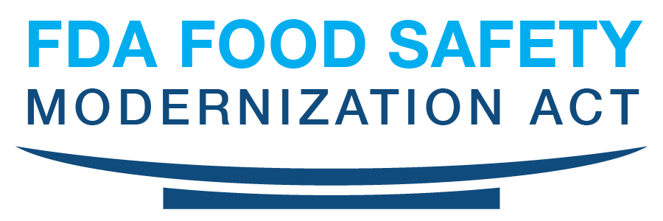
“FSMA Update and Recent Rules Implemented”
Beira Montalvo
FDA Compliance Officer
Human and Animal Food Operations
East Division IV (FL, PR, & US VI)
March 11, 2021

Slide 2
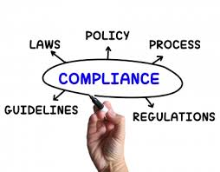
FDA Food Safety Modernization Act (FSMA)
Food Safety Modernization Act (FSMA) was signed into law by President Barack Obama on January 4, 2011.
The law was prompted after many reported incidents of foodborne illnesses during the first decade of the 2000s.
FSMA marks the biggest change to our nation’s food laws in more than 70 years. (1938 – Food, Drug, and Cosmetic Act)
Notes:
FSMA enacted in 2011 as a comprehensive reform of federal laws applicable to human food and animal food
Intention was for fewer recalls, and consumers benefit from fewer occurrences of foodborne illness outbreaks.

Slide 3
New Law Updates Authority and Tools
2011 – Food Safety Modernization Act
1976 Medical Device Amendments
1938 – Food, Drug, and Cosmetic Act
1906 – Pure Food and Drug Act

Slide 4
FDA Food Safety Modernization Act (FSMA)
“Preventing problems before they cause harm is not only common sense, it is the key to food safety in the 21st century.”
“We can not afford to wait until people become ill to realize their a problem”
Notes:
New Prevention-orientated system
Broad prevention mandate and accountability
Sets a standard of conduct.-Confirms industry’s primary role on food safety.
Prevention is the focus.
Science & Risk-based.

Slide 5
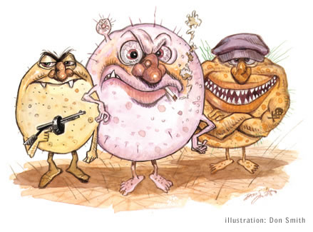
The Public Health Imperative
Salmonella
E. Coli O157:H7
Listeria
Foodborne illness is a significant burden
About 48 million (1 in 6 Americans) get sick each year
128,000 are hospitalized
3,000 die
Immune-compromised individuals more susceptible
Infants and children, pregnant women, older individuals, those on chemotherapy
Foodborne illness is not just a stomach ache—it can cause life-long chronic disease
Arthritis, kidney failure

Slide 6
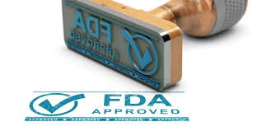
Why is the law needed?
Globalization
15 percent of U.S. food supply is imported
Food supply more high-tech & complex
More foods in the marketplace
New hazards in foods not previously seen
Shifting demographics
Growing population (about 30%) of individuals are especially “at risk” for foodborne illness

Slide 7
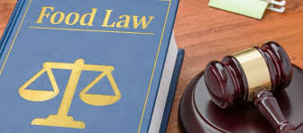
What’s so historic about the law?
Involves creation of a "New Food Safety System”
Broad prevention mandate and accountability New system of import oversight
Emphasizes partnerships
Emphasizes farm-to-table responsibility Developed through broad coalition
Notes:
FDA is an integral part of the food system rather than standing apart from the system as an enforcer of rules…..
FSMA build modern preventive measures into production operations… FSMA explicitly embraces the food safety role of the food industry, maning a complete overhaul -- prevention rather than reaction…

Slide 8
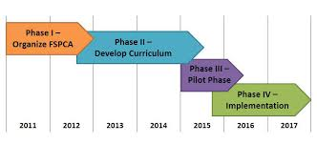
FSMA Overview
2011- Food Safety Modernization Act (FSMA) was signed into law
FSMA Implementation Approach
-Program alignment –
FSMA Implementation Guiding Principles
- Industry Training /Technical Assistance
- Regulator Training /Technical Assistance
- Stakeholder engagement throughout the process to help determine
reasonable and practical ways to implement provisions
FSMA Implementation in Phases “A Continuum”
Phase 1: Set standards
Develop regulations, guidance, protocols for new administrative enforcement tools
Phase 2: Implement standards
Design strategies to implement standards
Fully develop and implement the standards
Phase 3: Monitor, evaluate, refresh
- Pilot Phase
Phase 4: Implementation
Notes:
The FDA Food Safety Modernization Act or FSMA was enacted in January 2011 and requires FDA to deliver over 50 rules, guidances and reports to Congress. In light of this fact, FSMA implementation is a continuum and is and it has been carried out in overlapping phases.
Rulemaking Process Began
FSMA Implementation Approach
Implementation
Phase 1-Procedures, Policies, Practices
Phase 2- Trainings and pilots
Recordkeeping
Phase 3- Verification
Govt Inspections

Slide 9
Educate Before and While We Regulate
Notes:
Industry Training and Education
Food Safety Preventive Controls Alliance (FSPCA)
•Produce Safety Alliance (PSA)
•Sprout Safety Alliance (SSA)
FSMA Collaborative Training Forum
Jointly hosted by FDA and USDA
Provides a quarterly opportunity for the funded training organizations to: Share information about their programs;
Provide updates about their work; and
Discuss issues of common concern
Build collaboration and dialogue to enhance leveraging of programs.

Slide 10
Main Themes of the Legislation
Prevention
Enhanced Partnerships
Inspections, Compliance,
& Response
Import Safety
Notes:
Just after FSMA was enacted in 2011, six core teams with cross organizational FDA representation were formed to focus on delivering the highest priority FSMA mandates.
The six core teams established include:
Preventive Standards
Inspection and Compliance,
Imports,
Federal / State Integration, Fees, and Reports and Studies
.
Each core team has been charged with accomplishing specific FSMA deliverables. As the deliverables have been completed certain workgroups under the teams have been disbanded. In fact, certain core teams have completed all assigned work and have disbanded including the Fed/State Integration and Reports and Studies Teams.
The focus of the Preventive Standards and Imports core teams has been rulemaking including the review of the thousands of comments received in response to the proposed rules as well as associated guidance development and policy to establish the new prevention oriented standards mandated by FSMA.
Other core teams, including the Inspection and Compliance and Federal/State Integration core teams, have developed many ideas, for how FDA can better oversee the food industry, strengthen the global food safety system, and enhance public health protection.

Slide 11
Prevention: The Cornerstone of the Legislation
Comprehensive preventive controls for food and feed facilities
Prevention is not new, but Congress gave FDA explicit authority to use the tool more broadly
Strengthens accountability for prevention
Produce Safety Standards
Intentional adulteration standards (Food Defense)
Sanitary Transportation
Notes:
Prevention is the core principle (Foundation) of the FDA Food Safety Modernization Act enacted in 2011
The rule mandates to require comprehensive, science-based preventive controls across the food supply, including pet food and animal feed.
Comprehensive preventive controls for food and feed facilities
Prevention is not new, but Congress gave FDA explicit authority to use the tool more broadly
Strengthens accountability for prevention
Produce Safety Standards
Foreign Supplier Verification Program
Third Party Accreditation
Intentional adulteration standards (Food Defense)
Sanitary Transportation

Slide 12
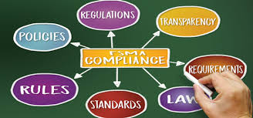
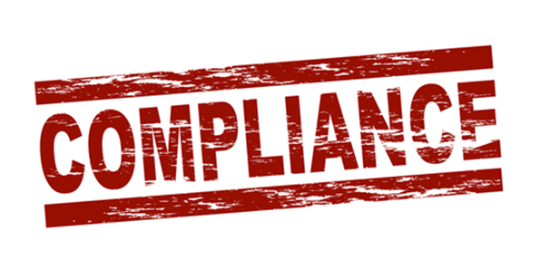
Inspection, Compliance & Response
Mandated inspection frequency
Frequency based on risk
New FDA Authorities / Tools
Mandatory Recall Authority
Expanded Records Access
Expanded Administrative Detention
Suspension of Registration
Enhanced Product Tracing
Accredited Laboratory Testing
Notes:
The FSMA recognizes that preventive control standards improve food safety only to the extent that producers and processors comply with them.
FSMA provides the FDA with new authority to conduct inspections and ensure compliance.
Mandated inspection frequency-
mandated inspection frequency, based on risk, for food and feed facilities
All high-risk domestic facilities must be inspected within five years of enactment and no less than every three years thereafter.
Records access-FDA will have access to records, including industry food safety plans and the records firms will be required to keep documenting implementation of their plans.
Testing by accredited laboratories-FSMA requires certain food testing to be carried out by accredited laboratories and directs the FDA to establish a program for laboratory accreditation to ensure that U.S. food testing laboratories meet high- quality standards.
Environmental Monitoring-During EI the CSO will look for any areas and niches that they feel may be a harborage point for bacteria.
Will take anywhere form 150- 200 swabs depending on how big the facility is.
May sample take raw material samples as well as finished product.
In Response to contaminants/violations
Mandatory recall- FSMA provides the FDA with authority to issue a mandatory recall when a company fails to voluntarily recall unsafe food after being asked to by the FDA.
Expanded Administrative Detention- FSMA provides the FDA with a more flexible standard for administratively detaining products that are potentially in violation of the law (administrative detention is the procedure the FDA uses to keep suspect food from being moved).
Suspension of Registration- FDA can suspend registration of a facility if it determines that the food poses a reasonable probability of serious adverse health consequences or death. (SAHCODHA). A facility that is under suspension is prohibited from distributing food.
Enhanced product tracing abilities- system establish to enhance its ability to track and trace both domestic and imported foods.
-methods to rapidly and effectively identify recipients of food to prevent or control a food borne illness outbreak.
Additional Record keeping for High Risk Foods- the rule expands access to records of related products if reasonable belief that they are likely to be affected in similar manner than food at issue---(risk) ---
Prior Authority-consisted of access records for food at issue.

Slide 13
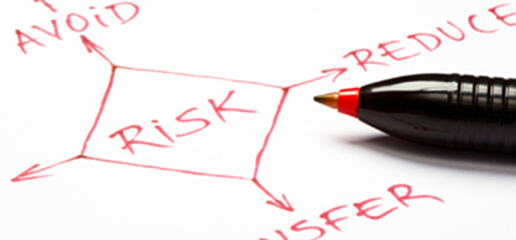
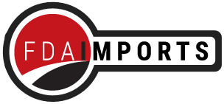
Import Safety: Most Groundbreaking Shift
Importers now responsible for ensuring their suppliers have adequate preventive controls in place
Can rely on third parties to certify that foreign food facilities meet U.S. requirements
Can require mandatory certification for high-risk foods
Voluntary qualified importer program--expedited review
Can deny entry if FDA access for inspection is denied
Requires food from abroad to be as safe as domestic

Slide 14
FDA
Recognizes
Accreditation Bodies
Accreditation Body (or FDA)
Accredits 3rd parties
Sec. 307
3rd Party Auditor
Certify high-risk
food imports
Voluntary Qualified
Importer Program
Importer inspection and
product certification enable
expedited product entry
Sec. 302
Foreign supplier
verification program
Foreign firms may use
Certification as a tool
Sec. 301
High-risk Food
Certification
When required by FDA
Sec. 303
Notes:
Sec. 301. Foreign supplier verification program
Requires importers to verify their suppliers use risk-based preventive controls that provide same level of protection as U.S. requirements and that product is not adulterated or misbranded.
Sec. 302. Voluntary qualified importer program
Allows for expedited review and entry of products from qualified importers received from certified facilities
Sec. 303. Certification for high-risk food imports
FDA has discretionary authority to require assurances of compliance for high-risk foods

Slide 15
Enhanced Partnerships: Vital to Success
Reliance on inspections by other agencies that meet standards
State/local and international capacity building
Improve foodborne illness surveillance
National agriculture and food defense strategy
Consortium of laboratory networks
Easier to find recall information
Notes:
State partners will play a significant role in FSMA inspections
State Dept. of Ag for Produce Safety Rule
Sate Dept. of Public Health for other rules
States are developing and maintaining a farm/firm inventory
Investment in State program infrastructure
Evaluating State legislative or regulatory authority

Slide 16
FSMA Implementation Approach
Implementation already underway
Coalition needed
Transparency a priority
Focus on public health protection
Engage with stakeholders to help determine reasonable and practical ways to implement provisions

Slide 17
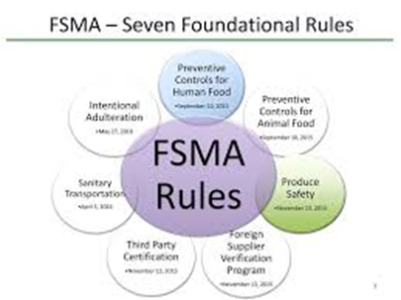
FSMA New Rules
Preventive Controls for Human Food (21 CFR Part 117)
Preventive Controls for Animal Food (21 CFR Part 507)
Produce Safety (21 CFR Part 112)
Foreign Supplier Verification Program for Importers of Food for Humans and Animals (Foreign Supplier) (Part 1, Subpart L)
Third-Party Accreditation
Sanitary Transportation of Human and Animal Food (1, Subpart O)
Mitigation Strategies to Protect Food Against Intentional Adulteration (Food Defense) (21 CFR Part 121)
Notes:
The FDA published seven major rules under FSMA, each of which created new requirements that put more responsibility on industry to prevent contamination of the U.S. food supply rather than reacting to it.
As these changes are properly implemented over the next several years, the food industry will benefit from fewer recalls, and consumers will benefit from fewer occurrences of foodborne illness outbreaks. This should result in a rare win-win situation in which government and industry work together to help the public and reduce risks in the industry.
I will briefly discuss the FSMA’s rules, as well as compliance dates

Slide 18
Brief overview of the major FSMA Rules and Compliance Dates
Notes:
FSMA includes several different regulations, often referred to as the seven pillars:
Preventive Controls for Human Food (Part 117)
Preventive Controls for Animal Food (Part 507)
Produce Safety (Part 112)
Foreign Supplier Verification (Part 1, Subpart L)
Sanitary Transportation (Part 1, Subpart O)
Intentional Adulteration (Part 121)

Slide 19
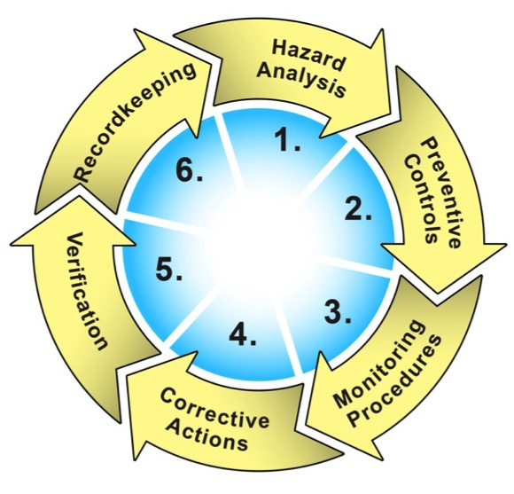
Current Good Manufacturing Practice, Hazard Analysis, and Risk-Based Preventive Controls (PC) Rules for Human Food (HF) (21 CFR 117) and Animal Food (21 CFR 507)
Applies to FDA food facilities required to register (with some exceptions) to implement a written Food Safety Plan:
-Hazard analysis and risk-based preventive controls
Evaluate hazards that could affect food safety;
Identify and implement preventive controls to prevent hazards;
Monitor controls and maintain monitoring records; and
Conduct verification activities
-Current Good Manufacturing Practice (cGMP)
-Supply-Chain Program
Notes:
The rule is found in Part 117. Part 117 contains updated CGMPs from 21 CFR 110 and the FSMA requirements for hazard analysis and risk-based preventive controls.
There are two key areas addressed by the preventive controls.
1. The first of these is the FSMA-mandated requirement that facilities conduct a hazard analysis and implement risk-based preventive controls for identified hazards. Each facility would be required to implement a written food safety plan that focuses on preventing hazards in foods.
2. The second key area relates to changes in the CGMP requirements.

Slide 20
Hazard analysis and Risk-based Preventive Controls
Evaluate known or reasonably foreseeable hazards to determine if they require a control
Biological, chemical and physical hazards
Naturally occurring or unintentionally introduced, or intentionally introduced for economic gain
May assess another’s hazard analysis

Slide 21
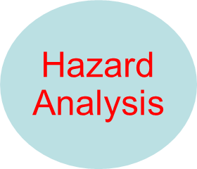
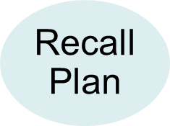
FSMA PC Food Safety Plan
Food Safety Plan
Process
Control
Supply-chain Program
Sanitation Control
Notes:
This diagram illustrates that the Food Safety Plan includes a number of elements. It starts with hazard analysis, which is used to identify required preventive controls for the process, for sanitation, for food allergens and supply‐chain programs, where these are needed to address the hazards requiring a preventive control. These elements, along with a recall plan make up the Food Safety Plan.
Many GMPs and other prerequisite programs are managed outside of the Food Safety Plan.

Slide 22
Compliance Dates Preventive Controls Rules for Human and Animal Food
Proposed: January 2013 (Human) Finalized: September 17, 2015 Compliance Dates: September 17, 2018
Very-small businesses (businesses that have less than $1,000,000 in total annual sales of human food, adjusted for inflation): September 17, 2018
Businesses subject to the Pasteurized Milk Ordinance: September 17, 2018
Small businesses (businesses with fewer than 500 full-time equivalent employees): September 18, 2017
All other businesses: September 2016
Proposed: October 2013 (Animal) Finalized: September 17, 2015 Compliance Dates: September 18, 2017
Small business (a business employee fewer than 500 full-time equivalent employees):
September 17, 2018
Very-small businesses
(a business averaging less than
$2,500,000, adjusted for inflation,
per year, during the 3-year period
preceding the applicable calendar year
in sales of animal food plus the market
value of animal food manufactured,
processed, packed, or held without sale
(e.g., held for fee or supplied to a farm
without sale). September 17, 2019,
except for records to support status as
very small business (January 1, 2017)
Notes:
A very small business is a business (including any subsidiaries and affiliates) that averages less than $2.5 million (adjusted for inflation) per year during the three-year period preceding the applicable calendar year in sales of animal food plus market value of animal food manufactured, processed, packed or held without sale (e.g., for a fee or supplied to a farm without sale).

Slide 23
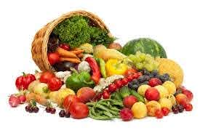
Produce Safety Rule (21 CFR Part 112)
Sec. 105. Standards for Produce Safety
Establish science-based, minimum standards for the safe production and harvesting of fruits and vegetables.
Applies to raw agricultural commodities for which FDA determines that such standards minimize the risk of serious adverse health consequences or death.
Notes:
The FDA’s Produce Safety Rule establishes science-based minimum standards for the safe growing, harvesting, packing, and holding of produce.
The rule puts more responsibility on farms to protect their crops from contamination by creating requirements for water quality testing, raw manure application, examining grazing areas, employee health and hygiene training, and more.
The rule gives special attention to sprouts due to their frequent association with foodborne illness outbreaks.

Slide 24
Compliance Dates Produce Safety Rule
Proposed: January 2013 Finalized: November 2015
Compliance Dates: Rage between Compliance dates for the FDA’s Produce Safety rule depend on a business’s size, exemption status, and whether or not the business deals with sprouts.
Covered activities involving sprouts covered under Subpart M
January 26, 2017: Large Farms
January 26, 2018: Small Farms (small businesses).
January 28, 2019: Very Small Farms (very small businesses).
(Large Business) The average annual monetary value of produce the farm sold during the previous 3-year period is more than $500,000: January 26, 2018
(Small businesses): The average annual monetary value of produce the farm sold during the previous 3-year period is more than $250,000 but not more than $500,000 January 28, 2019:
(Very small businesses) The average annual monetary value of produce the farm sold during the previous 3-year period is more than $25,000 but no more than $250,000): January 27, 2020

Slide 25
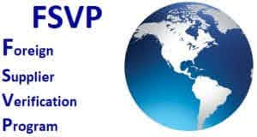
Foreign Supplier Verification Program (FSVP)Rule (Part 1, Subpart L)
Sec 301 - Purpose of FSVP
To provide adequate assurances that:
Foreign suppliers produce food using processes and procedures providing same level of public health protection as FSMA preventive controls or produce safety provisions
Food is not adulterated or misbranded (as to allergen labeling)
Notes:
The FSVP rule requires importers to verify their foreign suppliers are producing food in compliance with applicable FDA regulatory requirements.
To approve a supplier, an importer must evaluate the risks posed by foods it supplies by determining potential hazards associated with each food, as well as by evaluating the supplier’s performance (i.e., FDA compliance history).

Slide 26
Foreign Supplier Verification Programs
Importers are now required to perform certain risk‐based activities to verify that food imported into the US has been produced with the same food safety standards that are required of US producers (Produce Rule & Preventive Controls Rule)
Requires FSVP consisting of:
Compliance Status Review
- Hazard Analysis
- Verification Activities
- Corrective Actions
Periodic Reassessment of the FSVP
- Importer Identification: (DUNS)
- Recordkeeping
Verification Activities: onsite auditing, sampling and testing, review of supplier food safety records, or some other appropriate procedure.
Notes:
Importers must then implement an FSVP for each approved supplier and each food imported from that supplier.
The rule gives importers the flexibility to choose appropriate verification activities for each food and supplier.
Examples of potential verification activities include annual onsite audits of a supplier’s facility, sampling and testing a supplier’s products, or reviewing a supplier’s food safety records.

Slide 27
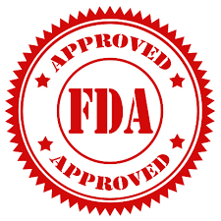
Compliance Dates FSVP Rule
Proposed: July 2013 Finalized: November 2015 Compliance Dates:
The latest of the following dates:
Importers of Food for Humans and Animals will be required to comply with Foreign Supplier Verification Programs (FSVP) after issuance of final rule, and the first compliance dates begin (May 30, 2017).
If foreign supplier is subject to preventive controls or produce safety regulations, importer must comply with FSVP 6 months after supplier must comply with the relevant regulations.

Slide 28
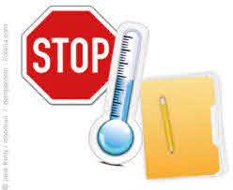
Sanitary Transportation Rule (Part 1, Subpart O)
Sec. 111. Sanitary Transportation of Human and
Animal Food
Addresses implementation of the Sanitary Food Transportation Act of 2005, which requires persons engaged in food transportation to use sanitary transportation practices to ensure that food is not transported under conditions that may render it adulterated
Notes:
The Sanitary Transportation rule created new requirements for shippers, receivers, loaders, and carriers that transport food in the U.S. by motor or rail vehicle to ensure food is protected during transportation, via both the design and maintenance of transportation vehicles and equipment and by taking appropriate measures to ensure food safety by maintaining proper temperature controls and protecting food from contamination.
Shippers, loaders, carriers, and receivers must develop written procedures detailing how they will ensure the safe transportation of food according to their specific requirements under the rule.
The Sanitary Transportation rule applies whether or not the food is offered for or enters interstate commerce.

Slide 29
Compliance Dates Sanitary Transportation Rule
Proposed: February 2014 Finalized: April 2016 Compliance Dates:
Small Businesses (businesses other than motor carriers who are not also shippers and/or receivers employing fewer than 500 persons and motor carriers having less than $27.5 million in annual receipts): April 2018
All other businesses: April 2017

Slide 30
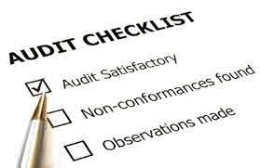
Third-Party Certification Rule
It establishes a voluntary program for the accreditation of third-party certification bodies (third-party auditors), to conduct food safety audits of eligible foreign entities (including registered foreign food facilities) and to issue certifications of foreign food facilities and the foods for humans and animals they produce.
Notes:
Accreditation of Third-Party Certification Bodies to Conduct Food Safety Audits and to Issue Certifications” (third-party certification regulation), to implement section 808 of the FD&C Act on accreditation of third-party certification bodies to conduct food safety audits of eligible foreign entities (including registered foreign food facilities) and to issue certifications of foreign food facilities and foods for humans and animals for purposes of Imports and exports and Voluntary qualified importer program
Accredited third-party certification bodies can perform two types of audits: consultative and regulatory.
A consultative audit is conducted in preparation for a regulatory audit, while a regulatory audit is the basis for certification.
Foreign facilities can use certification from a Third-Party Certification Body for two purposes: participation in the FDA’s Voluntary Qualified Importer Program (VQIP) or to satisfy a request by the FDA that a food exported to the U.S. be accompanied by this certification (a request that may be made if the FDA suspects a food has the potential to be harmful to U.S. consumers).
The results of a consultative audit may remain private, but a certification body is required to report to the FDA if a consultative audit reveals issues that may pose a serious risk to consumer health.
A regulatory audit, Third-Party Certification Body must provide the FDA with a full report on the results of its inspection.

Slide 31
Compliance Dates Third-Party Rule
Proposed: July 2013 Finalized: November 2015 Compliance Dates: N/A (Voluntary)
Program will launch after the final rule user fee rule takes effect.
Accreditation bodies could begin to apply when the program goes into effect.
- Third-party certification bodies could seek accreditation after one or more FDA-recognized accreditation bodies begin accepting applications.

Slide 32
Intentional Adulteration Rule (Food Defense) (21 CFR Part 121)
Two level inspectional approach
- Food defense plan Quick-Check inspection
*Conducted on covered facilities during food safety
inspections.
*High level review of Food Defense Plan (FDP)
- Comprehensive food defense inspections
*Conducted only at a limited number of prioritized
facilities.
*Conducted by specially trained investigators
*Critical evaluation of FDP, conclusion, rationale
Notes:
As with the FDA’s Preventive Controls Rules, the Intentional Adulteration Rule applies to all facilities required to register with the FDA as a food facility, unless covered by an exemption (see section titled “Exemptions”).
The rule requires facilities to develop and implement a written Food Defense Plan that assesses vulnerabilities within the facility, identifies a mitigation strategy for each vulnerability, and identifies monitoring procedures to ensure effectiveness of the mitigation strategies.
A QI must prepare a facility’s Food Defense Plan.

Slide 33
Compliance Dates Intentional Adulteration Rule
Proposed: December 2013 Finalized: May 2016 Compliance Dates:
Very-small businesses (a business [including any subsidiaries and affiliates] averaging less than $10,000,000, adjusted for inflation, per year, during the three-year period preceding the applicable calendar year in sales of human food plus the market value of human food manufactured, processed, packed, or held without sale [e.g., held for a fee]): July 2021
Small Businesses (a business employing fewer than 500 persons): July 2020
All other businesses: July 2019

