Slide 1
Modernized Current Good Manufacturing Practices, 21 CFR Part 117 Subpart B
Beira Montalvo and Pearl Lopina
FDA Compliance Officers
March 11, 2021

Slide 2
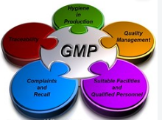
What Are Good Manufacturing Practices?
Current Good Manufacturing Practices (cGMPs) are defined in 21 CFR 117 Subpart B. This is an update from the previous definition, which was found in 21 CFR 110 and has been phased out.
Anyone who manufactures, process, packs or holds food (or beverage) is required to comply with CGMPs.

Slide 4
Cleanliness And Disease Control
Don’t work sick
Wear clean clothes
Shower daily, trim your nails when needed
Wash your hands before stating work, after eating, smoking or using the bathroom
No exposed jewelry except a plain possibly a wedding band
Gloves must be intact and changed when necessary
Wear hair nets and beard nets
Keep personal items out of production areas
Don’t eat in production

Slide 7
Grounds
Eliminate pest harborage (remove litter and waste, cut tall grass and weeds)
Maintain roads, yards, and parking lots in good condition
No standing water
Adequate was treatment and disposal
Pay attention to neighbors

Slide 9
Plant
Provide enough space around equipment to allow maintenance and cleaning
Eliminate potential sources of cross-contamination by engineering
Protect outdoor bulk storage and loading operations: use protective coverings, control areas over and around vessels, check for pests, and skim fermentation vessels.
Floors, walls and ceilings must be cleanable and in good repair, no drips!
Provide adequate shatter- proof lighting and ventilation
Air flow must be managed to avoid cross-contamination
Adequate screening or other pest protection for doors, windows, and other openings to the outside

Slide 11
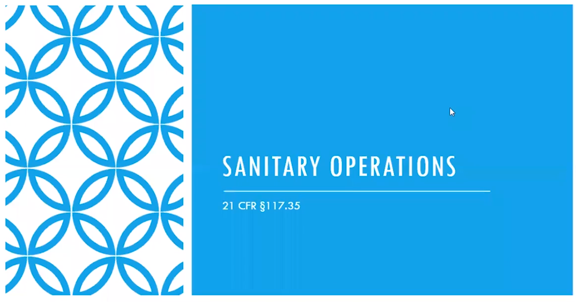

Slide 12
Sanitary Operations
Buildings and fixtures must be maintained in clean and sanitary condition and kept in good repair
Cleaning and sanitizing compounds must be safe and adequate, and this must be verified (purchased under letter of guarantee, or Safety Data Sheets (SDS) on file and reviewed)
Cleaning compounds must be identified and stored separately
Pest control is required
Food contact and non-food contact surfaces must be sanitized as regularly as necessary to maintain clean and sanitary operations
Cleaned and sanitized equipment and utensils must be protected from contamination

Slide 14
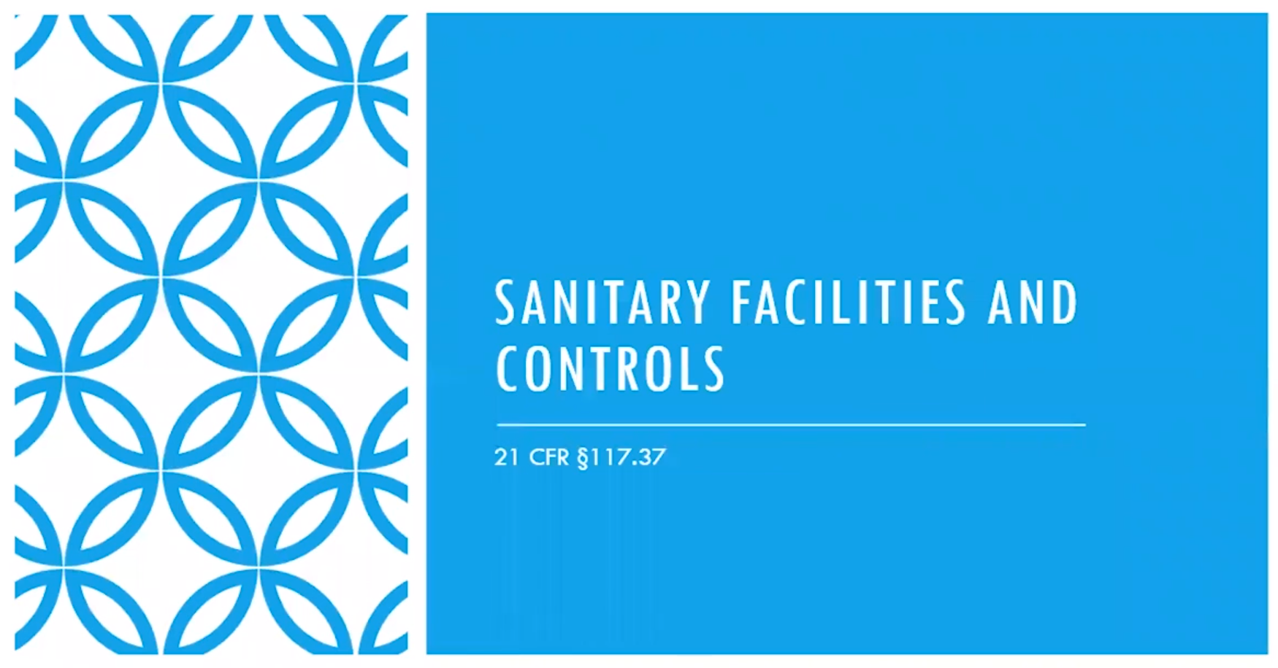

Slide 15
Sanitary Facilities And Controls
Adequate water supply (enough water, and from a good source)
Plumbing must provide enough drainage
Backflow preventers (must have records of backflow prevention testing)
Adequate sewage disposal
Clean toilet facilities, and enough for the number of employees
Hand-washing sinks must have hot and cold running water, soap and paper towels
Rubbish mush be disposed of properly so as not to attract pest or contaminate production

Slide 18
Equipment And Utensils
Equipment must be cleanable and well maintained
Avoid adulteration with lubricants, metal fragments, contaminated water, etc.
Installation must facilitate cleaning and maintenance
Food-contact surfaces must be corrosion-resistant, made of non-toxic materials and able to withstand normal operations (sanitation included)
Seams must be smoothly bonded and maintained to avoid accumulation of crud
Freezers and coolers must have temperature-indicating devices
Instruments used for measurements such as temperature, pH, alcohol content , water activity, etc. must be accurate and precise (calibrated)
Compressed air used in food-contact areas must be treated to avoid contamination

Slide 21
Processes And Controls (General)
All operations must be conducted in accordance with sanitary principles
Quality control must be in place for both products and packaging
Responsibility for sanitation must be assigned to one or more competent individuals
Adequate precautions must be taken against cross-contamination
Chemical, microbial or foreign material testing must be employed where necessary
Any food that is contaminated to the extent that it has become adulterated must be rejected, treated or processed to eliminate the contamination

Slide 23
Processes And Controls (Raw Materials And Ingredients)
Raw materials and ingredients must be inspected and segregated as necessary until they are determined to be clean and acceptable for use
Water must be of adequate sanitary quality*
Re-use of water is acceptable as long as it does not increase the contamination level of the food
Raw materials must either not contain unsafe levels of undesirable microorganisms or be treated
Raw materials susceptible to contamination with natural toxins, extraneous material, pests, or undesirable microorganisms must comply with FDA regulations*
Raw materials must be held properly to prevent adulteration
Frozen materials must be kept frozen
Bulk receipts must be stored in a manner that protects against contamination
Allergens must be segregated and properly handled

Slide 24
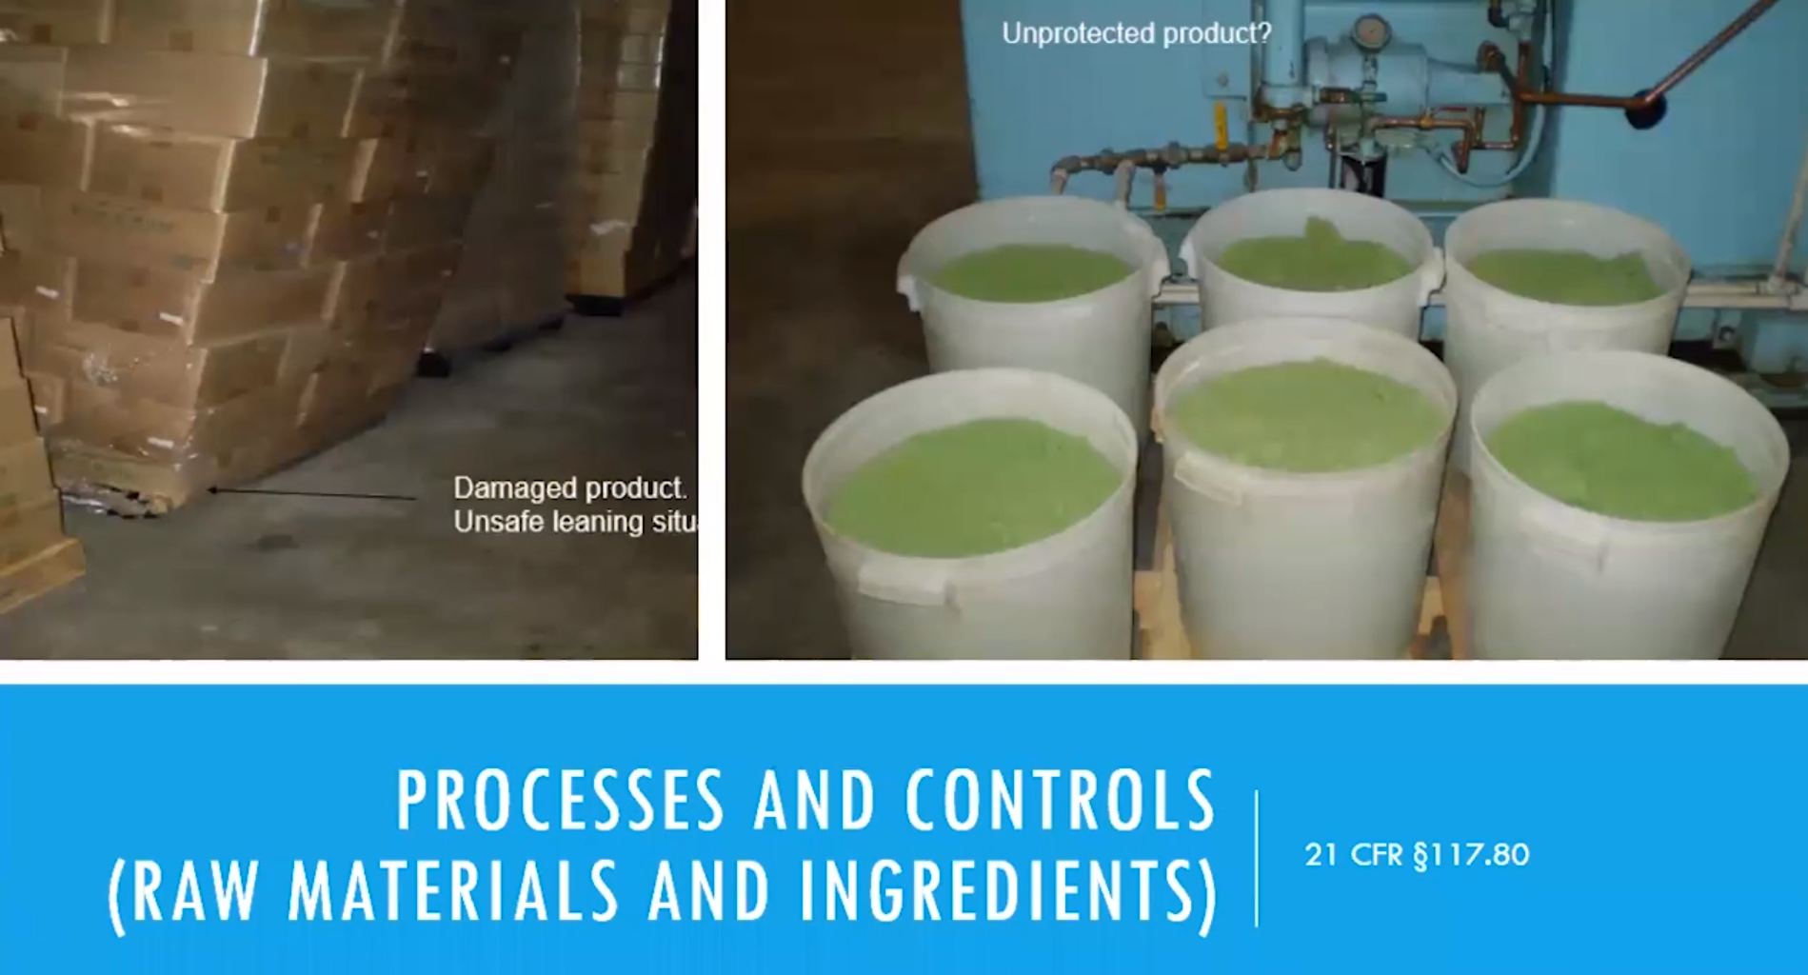

Slide 25
Processes And Controls (Manufacturing Operations)
Equipment and utensils must be maintained so they can be properly cleaned, and taken apart for thorough cleaning where necessary
All manufacturing, processing, packing and holding must be under conditions that prevent decomposition, adulteration, allergen cross-contact, and contamination
Food that can support fast growth of organisms must be kept cold/hot
Measures used to control microbial growth must be appropriate and adequate
Work-in-process (WIP) and re-work must be properly handled (watch allergens*)
Finished product must be protected from contamination from raw materials, other ingredients, or refuse
Unprotected raw materials and ingredients cannot be handled simultaneously with anything that might contaminate them (protect food on conveyors)

Slide 27
Processes And Controls (Manufacturing Operations)cont.
Equipment, containers and utensils used for raw materials/ingredients must be constructed, handled and maintained in a way that protects against contamination
Adequate precautions must be taken against the inclusion of foreign material
Steps such as washing, peeling, cutting, etc. must be performed in a way that protects against contaminants, including anything that might drip, drain, or be drawn in
If ice is used, it must be made from clean water according to GMPs
If the food does become adulterated, it:
*Must be disposed of properly so it does not contaminate other food
that:
*If it can be reconditioned, then the reconditioning must be done in a way
*Has been proven effective
*Can be reexamined and proven to no longer be adulterated before being incorporated
into other food

Slide 30
Warehouse And Distribution
Storage and transportation of food must be under conditions that will protect against contamination, as well as against deterioration of the product and container

Slide 32
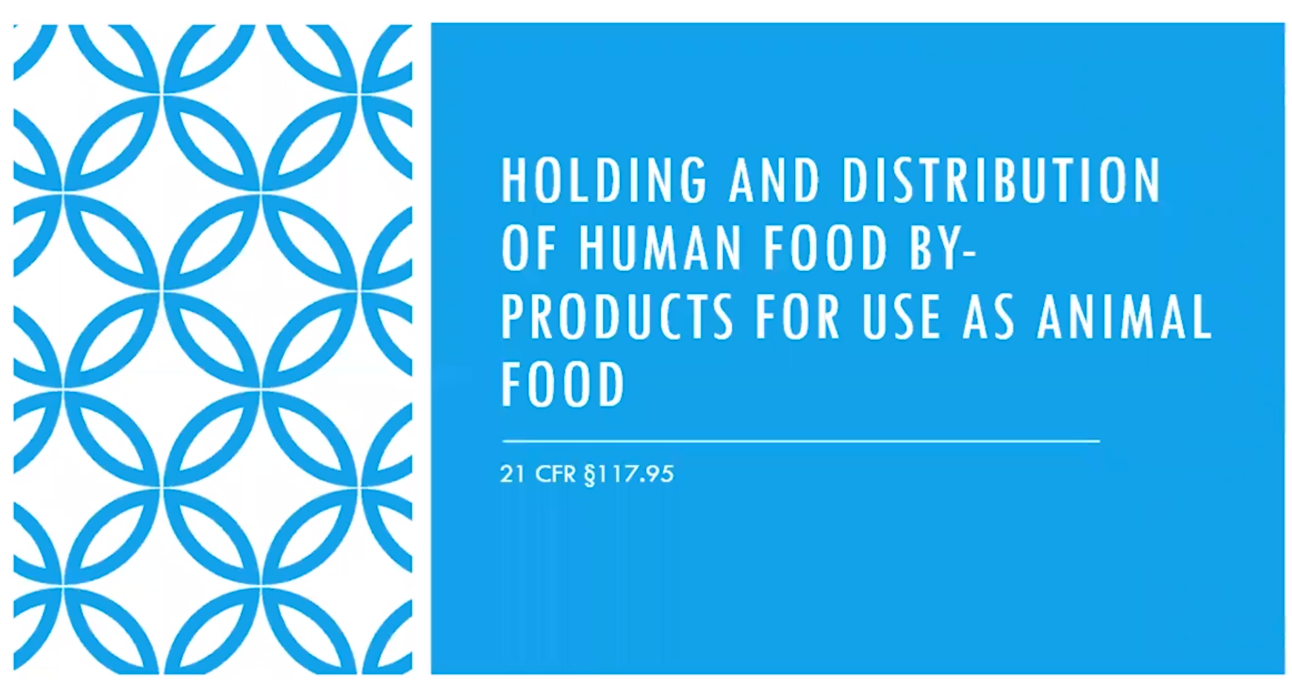

Slide 33
Holding and distribution of Human food by-products for use as animal food
Must be held under conditions that will protect against contamination
Containers and equipment must be designed, constructed of appropriate material, cleaned as necessary, and maintained to protect against contamination
Must be held in a way to protect against contamination from sources such as trash
During holding, must be accurately identified
Labeling that identifies the by-product by the common or usual name must be affixed when distributed
Shipping containers and bulk vehicles must be examined prior to use
Refer to 21 CFR 507 for more information about animal food requirements

Slide 35
Cross Contamination

Slide 37
Be Proactive
Understand your facility's needs.
Look for conducive conditions.
Reduce attractants.
Pay attention to the exterior.
Implement non-chemical exclusion techniques.
Maintain a sanitary environment.
Implement an employee hygiene program.
Train and educate.
Maintain records and perform trend analysis.
Conduct regular Prerequisite Program (PRP) assessments

Slide 38
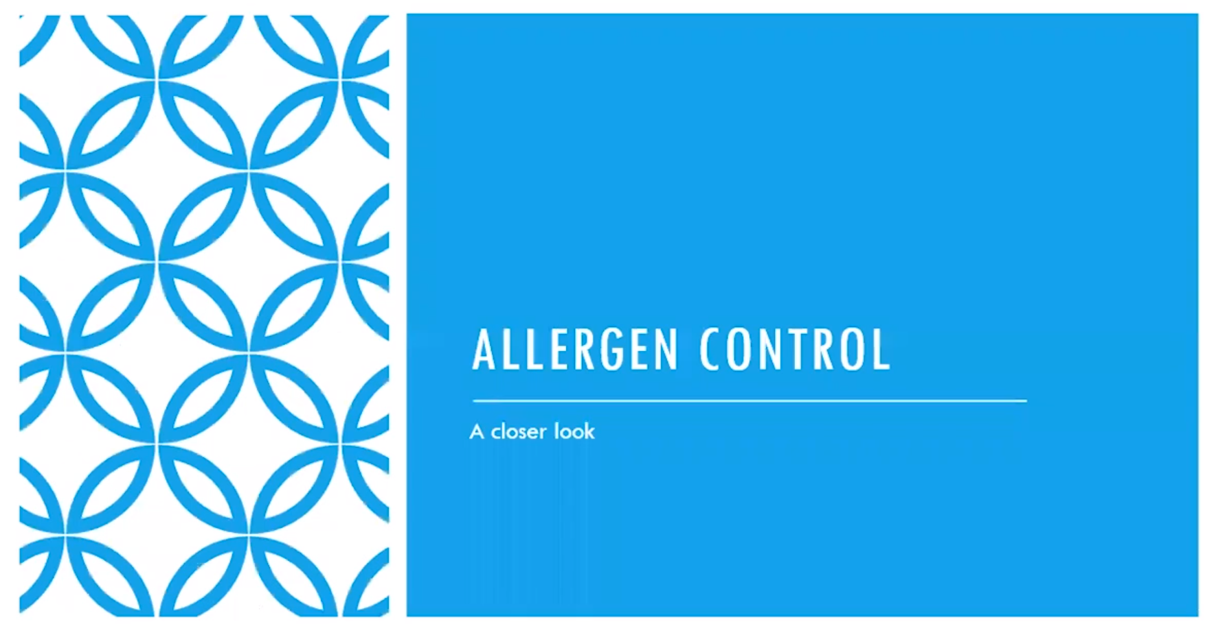

Slide 39
Allergen Control

Slide 40
Allergens in cGMPs
The word “Allergen” appears 153 times in the current Good Manufacturing Practice, Hazard Analysis and Risk-based Preventive Controls for Human Food regulation. (Agency really means it*)
New term-cross-contact
Allergens must be segregated, both from each other and from non-allergenic foods.
There must be adequate GMPs to ensure there is no cross-contact during storage or processing.
Employee training on allergens is required and must be documented.
Visually clean is the minimum requirement under the law. This is defined as no residue, film, or sheen.

Slide 41
Industry best practices include:
18-inch perimeter between stored items and walls to allow for cleaning and pest control
Clearly defined lines on floor to delineate storage areas and footpaths
Ensure adequate air flow, temperatures and humidity control.
Provide a separate area for non-conforming materials.
Practice stock rotation
Store waste materials and chemicals separately from food.
Avoid the use of fork lifts that create exhaust.
Be aware of contamination that can be tracked in on forklift wheels.
Dedicate bulk containers whenever possible.

Slide 42
Questions

